Slide 1
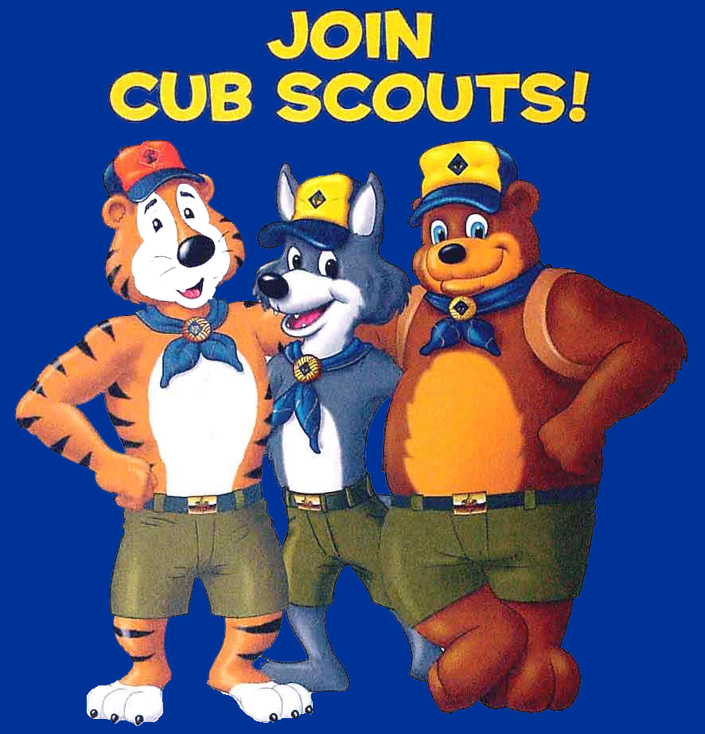
Pack 888
Growing boys and their families from [SCHOOL]
Notes:
Thank for taking the time out of your schedules to learn about Cub Scouting.
While fun and exciting for your boy, as you’ll see, Cub Scouting is also an investment his future.
The assembly of leaders and scouts in this hall is called, Pack 272
I’ll explain the scouting organizational structure, but first I want to share a brief background of scouting, its goals and where your boys will enter based on his age and grade in school

Slide 2
Tonight 7:00 – 8:30
A Quick Peek at what fun Cub Scouts have
A Sneak Peek at what the Pack can do next year
Fun Game for Everyone
Go over the Scouting program
  Core of Scouting
  Organizing the Pack and Dens
  Paperwork
Next Steps and Closing Comments
Closing (head to Administration Table)

Slide 3
Last year’s FUN

Slide 4
INSERT SLIDESHOW HERE

Slide 5
What DO YOU WANT TO do this year?

Slide 6
GROUP GAME
Scouts and Family (everybody)
Teams of 6-8 people (stay within Den families) – mix adults & youth

Slide 7
Newspaper Game
Quickly pick one boy to be the “model”
Quickly pick one adult to be the “spokesperson”
Using Newspaper and Tape, you have 5 minutes to dress your model in a costume:
  Super hero
  Wizard
  Knight
  <you decide>
GO !!!!!!!!!!!!!

Slide 8
About Scouting

Slide 9

100 Years of Scouting
Boy Scouting began in England in 1907-08
Today, Scouting is found in 185 countries
Boy Scouts of America began in 1910
“Cub Scouts” began in 1930
Notes:
Scouting has a long and proud tradition of providing a foundation for developing young boys into responsible men.

Slide 10
Goals of Scouting
Character Development
Citizenship
Compassion
Cooperation
Courage
Faith
Health and fitness
Honesty
Perseverance
Positive attitude
Resourcefulness
Respect
Responsibility
Character Development… Disguised as FUN!
Notes:
Cub Scouting is a year-round family-oriented program where parents, boys, leaders, and organizations work together to develop your boy’s character.
Yes, it’s character development -- made up of many dimensions – but to the boys, it’s just having FUN!

Slide 11
Results of Scouting
1 in 4 boys will be a Scout.
Out of 100 scouts:
4 will reach Eagle rank, and at least one will later say that he valued his Eagle above his college degree.
1+ will use it to save another person's life … many will credit it with saving their own.
Only rarely will one ever appear before a juvenile court judge.
17 will later become Scout leaders and will give leadership to thousands of add’l boys.
Half will serve in the military, and in varying degrees, profit from their Scout training.
Out of the leaders in this nation in business, religion & politics, 3 out of 4 were Scouts.
Almost all will develop hobbies that will add interest throughout the rest of their lives.
Many will find their future vocation through merit badge work and Scouting contacts.
Each of the one hundred will learn something from Scouting.
Notes:
Cub Scouting is a year-round family-oriented program where parents, boys, leaders, and organizations work together to develop your boy’s character.
Yes, it’s character development -- made up of many dimensions – but to the boys, it’s just having FUN!

Slide 12
Results of Scouting
Nationwide survey of high-schools:
85% of student council presidents were Scouts
89% of senior class presidents were Scouts
80% of junior class presidents were Scouts
75% of school publication editors were Scouts
71% of football captains were Scouts
Scouts also account for:
72% of Rhodes Scholars
70% of Annapolis graduates
68% of West Point graduates
64% of Air Force Academy graduates
85% of FBI agents
26 of the first 29 astronauts
Notes:
Cub Scouting is a year-round family-oriented program where parents, boys, leaders, and organizations work together to develop your boy’s character.
Yes, it’s character development -- made up of many dimensions – but to the boys, it’s just having FUN!

Slide 13
Results of Scouting
Scouts have Higher Education levels
15% higher highschool graduation rates
Scouts are Better Leaders
50% more likely as adults to have leadership responsibilities at work
Scouts have Stronger Values
44% more likely to agree “helping others should come before one’s own interests”
Scouts are More Service Oriented
33% more interested in volunteer service
Character Education
94% of Scouting parents feel that their children learn morals and values in the BSA program
74% of Scouting Youth feel the BSA program helps them tell the difference between right and wrong
Notes:
Cub Scouting is a year-round family-oriented program where parents, boys, leaders, and organizations work together to develop your boy’s character.
Yes, it’s character development -- made up of many dimensions – but to the boys, it’s just having FUN!

Slide 14
You and your BOY

Slide 15
0
100
Statistically, your son could live to be about 100

Slide 16
0
50
As parents
We will live to around 80
We are 30 today (average)

Slide 17
0
20
By the time they are 20,
they are “own their own”
(stop listening)

Slide 18
0
15
15
By the time they are 20,
they stop listening

Slide 19
7
15
They are at least 7 now

Slide 20





This is Your Time !
7
15+
7 or 1st Grade = Tiger Cub
8 or 2nd Grade = Wolf Cub
9 or 3rd Grade = Bear Cub
10-11 or 4th-5th Grade = Webelos
12-18 or Middle/High School = Boy Scout

Slide 21
PACK organization
We are ALL here for the Boys !

Slide 22
We are ALL here for the boys
Boy Scouts of America

Slide 23
We are ALL here for the boys
Boy Scouts of America
Councils
Councils
Councils

Slide 24
We are ALL here for the boys
Boy Scouts of America
Circle 10 Council
North Texas

Slide 25
We are ALL here for the boys
Boy Scouts of America
Circle 10 Council
North Texas
Councils
Councils
Districts

Slide 26
We are ALL here for the boys
Boy Scouts of America
Circle 10 Council
North Texas
Five Trails District
Irving & Coppell

Slide 27
We are ALL here for the boys
Boy Scouts of America
Charter Organization
Local School(s)
Circle 10 Council
North Texas
Five Trails District
Irving & Coppell

Slide 28
We are ALL here for the boys
Boy Scouts of America
Charter Organization
Local School(s)
Our Cub Scout Pack
Circle 10 Council
North Texas
Five Trails District
Irving & Coppell

Slide 29
We are ALL here for the boys
Cub Scout Pack 888
Committee
Den
6-8 boys of same grade
Den
6-8 boys of same grade
Den
6-8 boys of same grade
Den
6-8 boys of same grade
Den
6-8 boys of same grade
Den
6-8 boys of same grade
Advancement
Patches and Bling
Popcorn Sales
Fund Raising
Scouting 4 Food
Canned Food Drive
Pinewood Derby
Pit Boss
Each Den needs:
Committee Representative
Den Leader
Asst. Den Leader
Event Planning
Other Activities
Blue & Gold
Banquet
Camping
Fall Campout
Spring Campout
Day Camp
Religious Progms
Interfaith opportunities
Charter

Slide 30




We are ALL here for the boys
Cub Scout Pack 888
Den 1
4^{th &} 5th grade
Den 2
3rd grade
Den 3
2nd grade
Den 4
1st grade

Slide 31
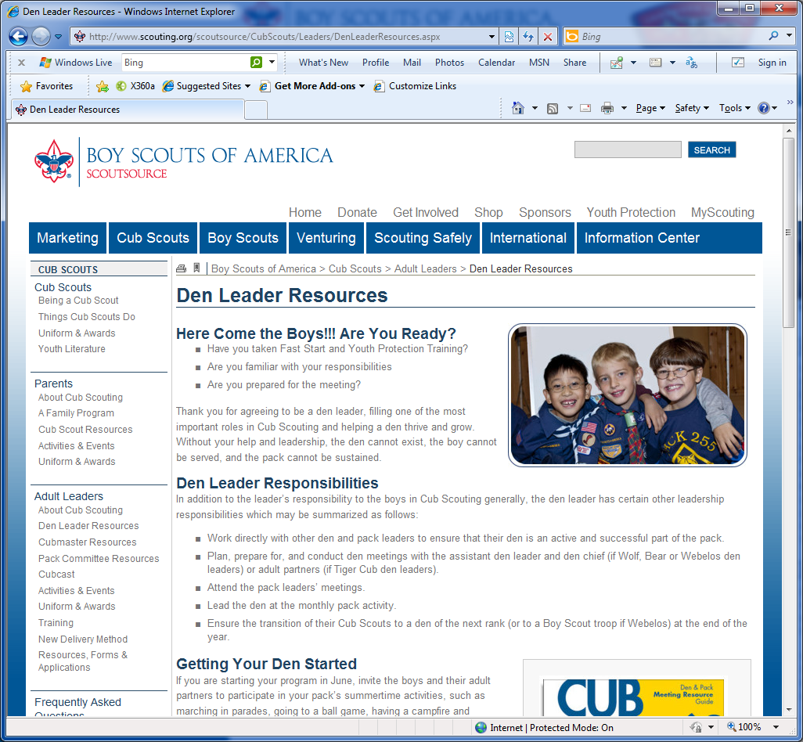
We are here for you, adults
www.Scouting.org

Slide 32
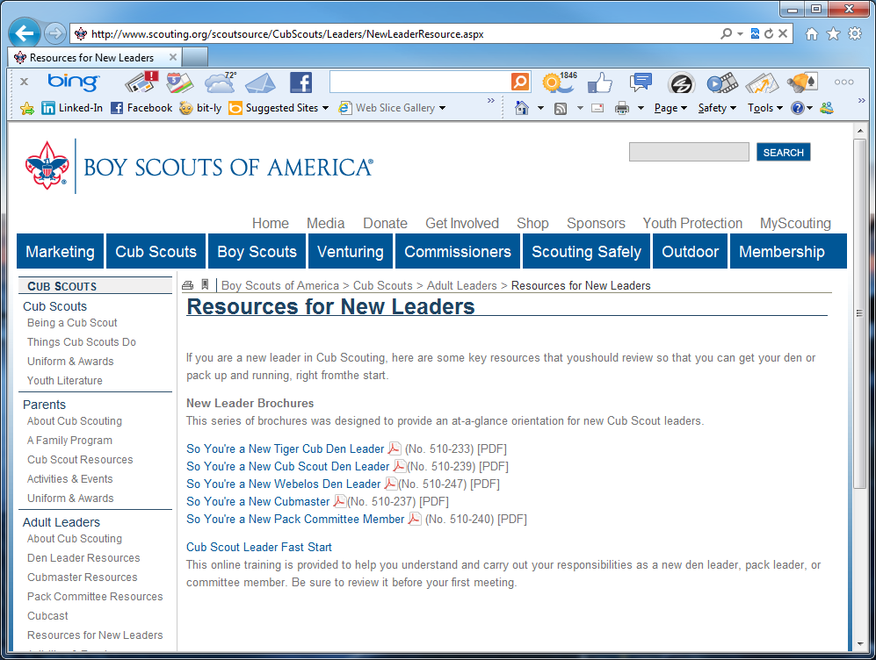
We are here for you, adults
www.Scouting.org

Slide 33
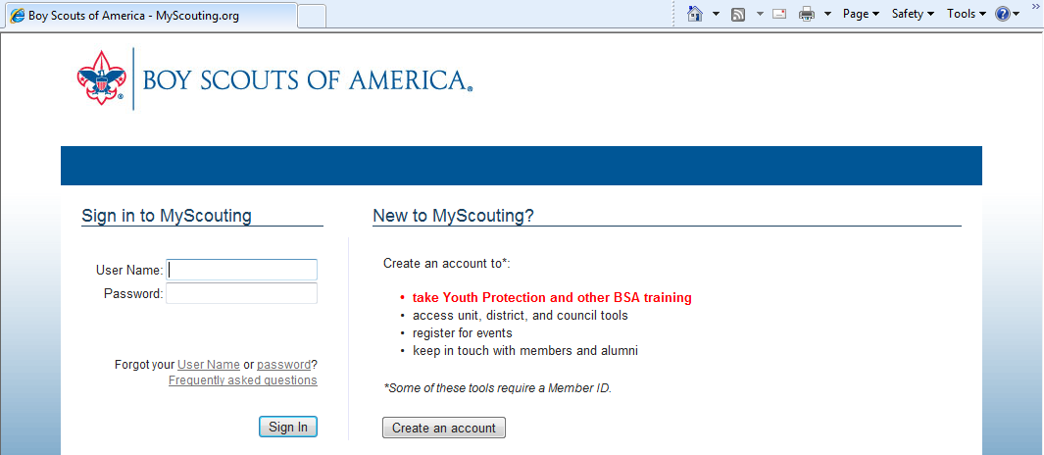
Online Training
www.MyScouting.org

Slide 34
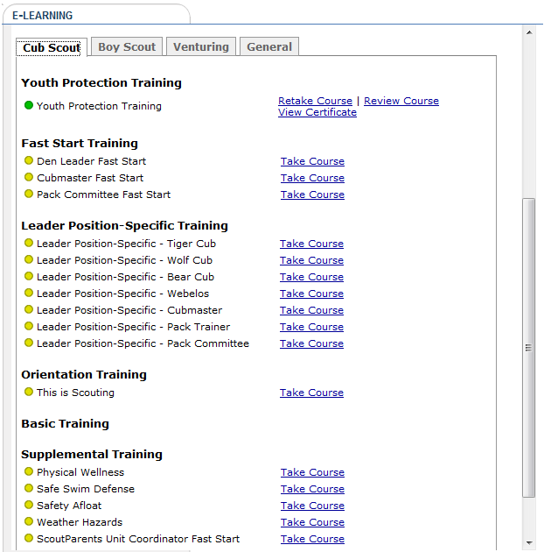
Online Training
Every Adult Leader MUST take Youth Protection Training (YPT)
Encouraged for every parent
www.MyScouting.org
Role Specific Training
Role Specific Training
Role Specific Training
Role Specific Training
Basic Overview of Scouting

Slide 35
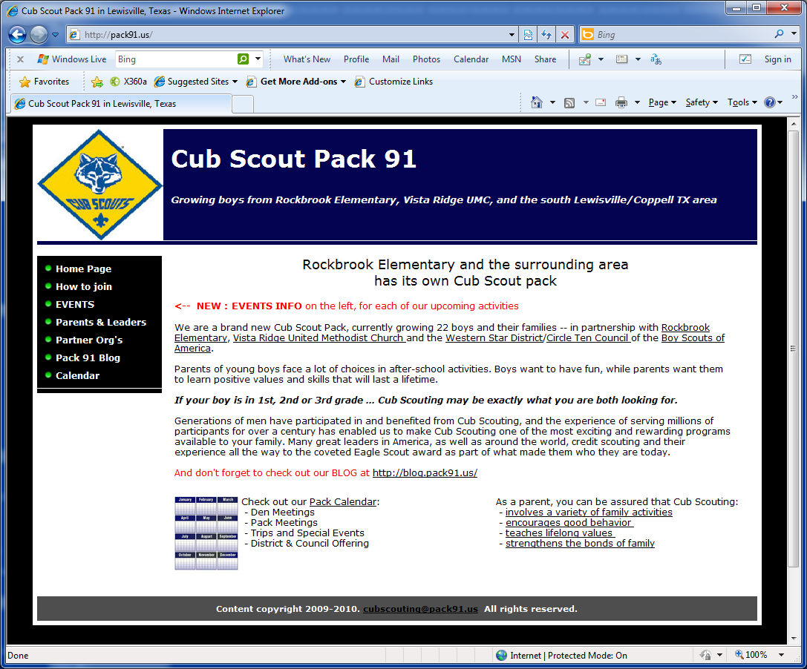
Pack Website (coming soon)

Slide 36
FormING THE PACK

Slide 37
Pack Organization
Cubmaster
Asst. Cubmaster
Den Leader
Den Leader
Den Leader
Den Leader
Asst. Den Leader
Comm. Member
Asst. Den Leader
Comm. Member
Asst. Den Leader
Comm. Member
Asst. Den Leader
Comm. Member
DEN 4 Tigers (1st)
DEN 3 Wolves (2nd)
DEN 2 Bears (3rd)
DEN 1 Webelos (4th)

Slide 38
Pack Organization
Cubmaster
Asst. Cubmaster
Den Leader
Den Leader
Den Leader
Den Leader
Asst. Den Leader
Comm. Member
Asst. Den Leader
Comm. Member
Asst. Den Leader
Comm. Member
Asst. Den Leader
Comm. Member
DEN 4 Tigers (1st)
DEN 3 Wolves (2nd)
DEN 2 Bears (3rd)
DEN 1 Webelos (4th)

Slide 39
Committee Organization
Organization Head
Committee Chair
Day Camp
Website
Finance
Cubmaster
“awesome week”
Two on-site
co-leads
“need checking
acct”
Dues in … Fees out
“cookie cutter
preformed”
INFO & Email

Slide 40
Form YOUR DENS

Slide 41
Form your Den
Families comprise the Dens
  Boys work on age-appropriate badges and awards with their parents or guardians at home, using their scout book.
  Parents, guardians and other family adults are needed to serve as Pack leaders, Committee members, and Den leaders, and as helpers at Pack and Den meetings, activities, trips, fund raisers, etc.
  The Pack can only work with active parents, in the Dens and in the Pack.

Slide 42
Form your Den
1. Committee Representative
Attend monthly committee meeting, help with administrative tasks and events, keep den informed
2. Assistant Den Leader
Help plan and deliver with monthly Den meeting, stand in when Den Leader is unavailable, and have fun with boys!
3. Den Leader
Plan and deliver monthly Den meeting, track advancements of boys within Den, Have Fun !

Slide 43
HOw TO BEGIN
Paperwork

Slide 44
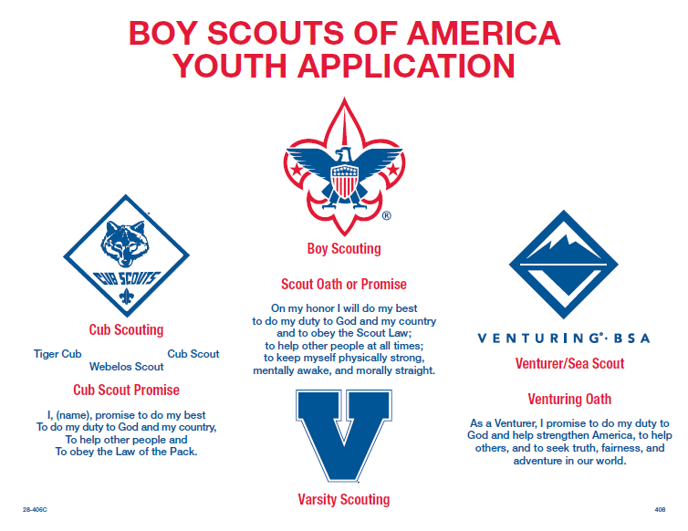
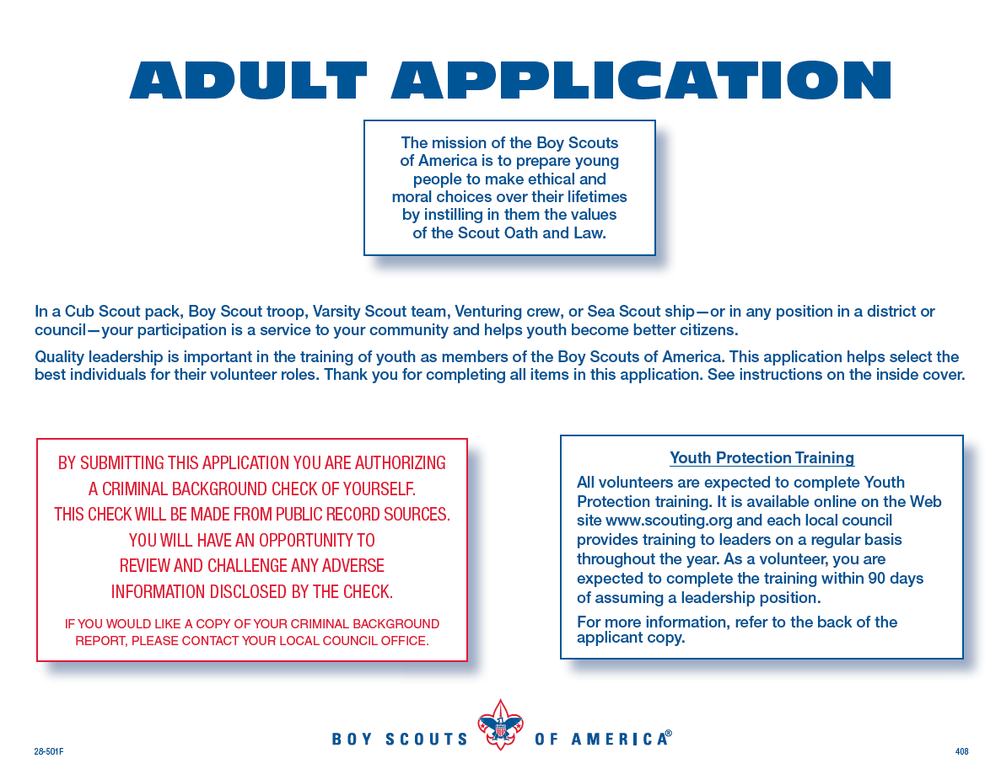
Membership Forms
Youth Application for Boy …. and You !

Slide 45
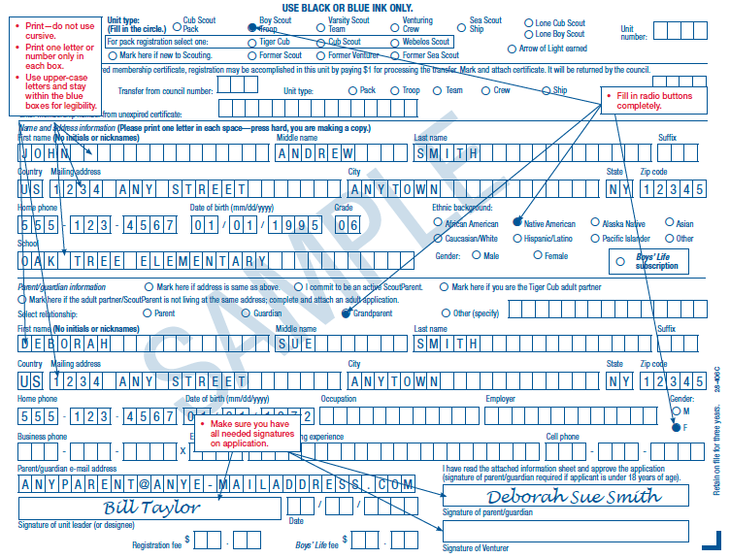
Membership Forms
Cub Scout Pack
0 8 8 8
Scout Leader
Parent
Not applicable

Slide 46
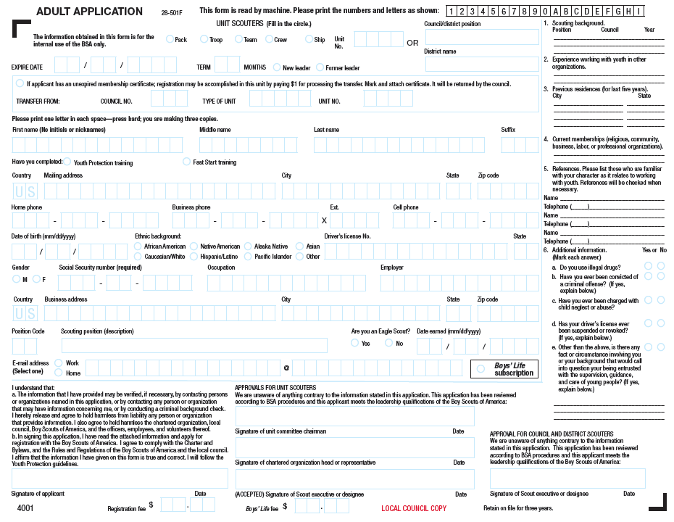
Adult Forms
0 8 8 8
Pack
blank
blank
MC – Committee Member
DL – Den Leader
TL – Tiger Den Leader
DA – Asst. Den Leader
You sign here
15.00
0.00

Slide 47
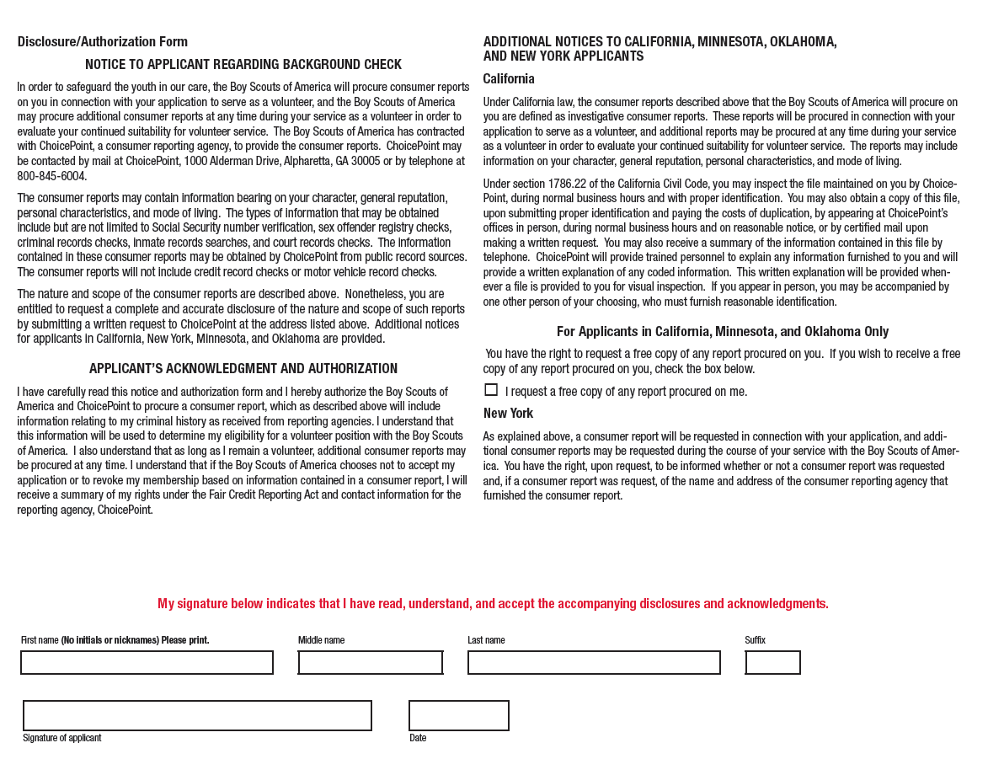
Adult Forms
Be sure to put in 3 references
Must also sign background check approval

Slide 48
Membership Fees
First Year BSA Membership * 15.00
Boys Life magazine subscription 12.00
Adult First Year Membership * 15.00
Checks payable to Cub Scout Pack 888
* scholarship assistance may be available

Slide 49
Membership Fees
First Year BSA Membership * 15.00
Boys Life magazine subscription 12.00
Pack 888 Dues (patches/materials) 15.00
Adult First Year Membership * 15.00
Checks payable to Cub Scout Pack 888
* scholarship assistance may be available

Slide 50
Membership Fees
First Year BSA Membership * 15.00
Boys Life magazine subscription 12.00
Pack 888 Dues (patches/materials) 15.00
Pack 888 T-shirt 8.00
Adult First Year Membership * 15.00
Adult Pack 888 T-shirt 10.00
Checks payable to Cub Scout Pack 888
* scholarship assistance may be available

Slide 51
Membership Fees
First Year BSA Membership * 15.00
Boys Life magazine subscription 12.00
Pack 888 Dues (patches/materials) 15.00
Pack 888 T-shirt 8.00
50.00
Adult First Year Membership * 15.00
Adult Pack 888 T-shirt 10.00
25.00
Checks payable to Cub Scout Pack 888
* scholarship assistance may be available

Slide 52
The costs of scouting
Statistically, the pack will spend about $120 per boy!
Annual Pack Dues and Registration fees are $50 per year.
Somehow, some way, the Pack needs to raise $70 per boy to remain solvent.
Your participation in our fund raisers is critical. Please do your best to help!

Slide 53
Fund Raising
To defray costs of activities, cubs sell Popcorn each fall. New for 2010, we will maintain an account per scout for their personal earnings.
For example:
    Scout sells $750 in popcorn $750
    The Pack earns 26% $200
    50% of Pack earnings credited to individual boy $100
    Camping Fees - 30
    Summer Camp * - 70
    * scholarship assistance may be available

Slide 54
Charitable Donations
The Charter Organization of Pack 888 is a 501c3 charity. If your employer matches charitable donations, you can help our Pack:
Donation to:
Cub Scout Pack 888

Slide 55
Email @Pack888.us
FirstName@pack888.us all adult leaders
DEN3@pack888.us all members of each den
FFLL#@pack888.us each scout (parents)
e.g. Johnny Smith of Den 3 is JoSm3@pack888.us
When in doubt – Cubscouting@Pack888.us

Slide 56
NEXT STEPS

Slide 57
Schedule
 | Mon | Tue | Wed | Thu | Fri | Sat | Sun
Week 1 |  |  | Webelos Den 3 |  |  |  | Wolves Den 5
Week 2 | Cub Scout Roundtable (district)
Week 3 | Committee |  | Wolves Den 5
Week 4 | Pack Meeting
Week 5 | ----
No Homework?
First Pack Meeting for this year is September 27 at 7PM
Each Den can decide when it should meet, based on the needs of your boys

Slide 58
Upcoming Dates
Sept 20 Committee Meeting @ 6:30
Sept 25 Dallas Cowboys Scout Day (details pending)
Sept 25 Adult Leader training (in person)
Sept 27 Pack Meeting @ 7PM
Popcorn Info to be given
Oct 23 Pack Trail Hike (sign up in back)
Oct 29-30 Webelos & Boy Scout Camporee
TBD – God & Me class being scheduled for Fall

Slide 59
Calendar Highlights
Annual pack activities your family can look forward to:
October Trail Hike & Centennial Camporee
November Fall Family Campout
December God & Me lock-in
January Pinewood Derby (workshops prior)
February Scouting for Food, Scout Sunday at local churches
March Spring Family Campout or Camp-in
April Blue & Gold Banquet
June Day Camp

Slide 60
SUIT UP !!
Scout Shop @ 121(Business) & Corporate – behind McDonalds
Get your materials early, they sell out each Fall

Slide 61


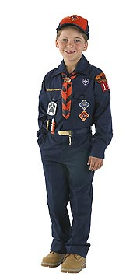
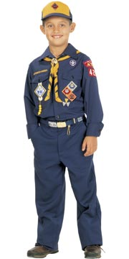
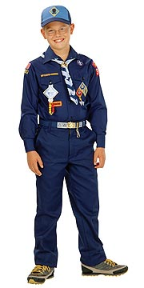
Tigers, Wolves & Bears
Blue shirt, belt & buckle
Scarf & slide
Hat
Above left pocket
DEN #
1st Grade
Tigers
Orange
2nd Grade
Wolves
Yellow
3rd Grade
Bears
Lt. Blue
Left Sleeve
Circle 10 Council
8
8
8
Right Sleeve

Slide 62
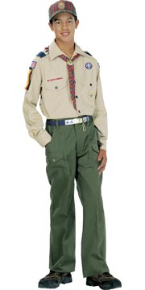
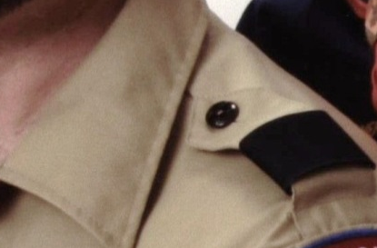
Webelos
Brown shirt, belt & buckle
Webelos scarf & slide
Webelos banners on shoulder
Webelos or BSA hat
Above left pocket
Patrol Animal
Left Sleeve
Blue shoulder epaulets
Circle 10 Council
8
4
4
Right Sleeve

Slide 63

Adult Leaders
Brown shirt, belt & buckle
Any BSA hat
Above left pocket
Left Sleeve
Blue shoulder epaulets
Circle 10 Council
8
4
4
Adult Right Sleeve

Slide 64


Pack T-Shirts
sample

Slide 65






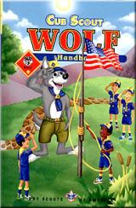
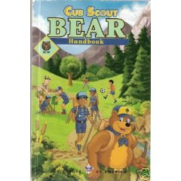

Start your adventure
Every scout starts on the Bobcat trail
Then, you will begin working your program

Slide 66
Cub Scout Promise
I, (your name), promise to DO MY BEST
To do my DUTY to GOD and my COUNTRY
To HELP other people,
and To OBEY the LAW of the Pack

Slide 67
The Law of the Pack
The Cub Scout follows Akela.
The Cub Scout helps the pack go.
The pack helps the Cub Scout grow.
The Cub Scout gives goodwill.

Slide 68

Start your adventure
Every scout starts on the Bobcat trail
Cub Scout Salute
Cub Scout Sign
Cub Scout Handshake
Cub Scout Motto
Cub Scout Promise
Law of the Pack

Slide 69
Pack 888
Growing boys and their families from Vista Academy
Notes:
Thank for taking the time out of your schedules to learn about Cub Scouting.
While fun and exciting for your boy, as you’ll see, Cub Scouting is also an investment his future.
The assembly of leaders and scouts in this hall is called, Pack 272
I’ll explain the scouting organizational structure, but first I want to share a brief background of scouting, its goals and where your boys will enter based on his age and grade in school

